Slide 1

Celebrating 20 Years!
Presented by Sarah Peurakoski, Executive Director
February 24, 2018

Slide 2
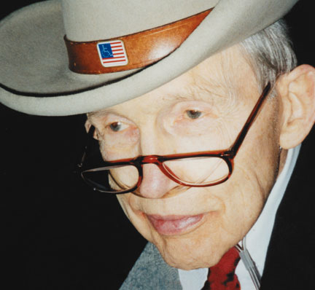
“There is a distinct and vital difference between society/government that empowers people, and a society/government that provides for them and regulates them for their own good….empowerment is when government joins with business, labor, religion, and individual citizens to guarantee every person the tool to govern, to produce and to live the best life possible for self and for all…we [people with disabilities] have unique knowledge and experience to offer. We have the responsibility to lead.”
Quote by Justin Dart (1930 – 2002)
Contracted polio in 1948 and spent the rest of his life using a wheelchair
Leader in the disability rights movement for 30 years
“Father” of the Americans with Disabilities Act – who stood on the podium with President George H. Bush when he signed the ADA into law in July 1990.
Self-proclaimed “soldier of justice”

Slide 3
THEN
NOW
SAIL is formed as only center for independent living in the U.P.
Cost of stamp: $0.32
Cost of gallon of gas: $1.06
President: Bill Clinton
Workforce Investment Act was signed by Clinton
Popular Films: Armageddon, Titanic, Saving Private Ryan
Popular Musicians: Celine Dion, Madonna, Chumbawamba, Spice Girls
SAIL continues to grow and thrive as the only center for independent living in the U.P.
Cost of stamp: $0.47
Cost of gallon of gas: $2.69
President: Donald Trump
Workforce Innovation and Opportunities Act was signed in 2014
Popular Films: Wonder, Star Wars: The Last Jedi, Get Out
Popular Musicians: Taylor Swift, Beyonce, Drake, Bruno Mars

Slide 4

SAIL TIMELINE
AT a glance

Slide 5
the first 5 years
SAIL is incorporated as a 501(c)(3) organization and begins operating at 129 W. Baraga Avenue coined The Marquette Non-Profit Commons
Amy Rosemergy becomes the first Executive Director
$111,375 approximate budget starts from Michigan Rehabilitation Services
First Action Day, May 2000 with over 220 people in attendance
Initial programs and services launch including:
      ADA Access Team
      RICC
      IL core services
      STOMP (Students On Mentoring Peers)
      Nursing Home Transition
Annual operating budget increases to $265,000, with five direct staff and two administrators
“Tour of Hope” benefit concert supports SAIL and NAMI (National Alliance on Mental Illness)

Slide 6
The second 5 years
Multiple executive director changes and other staff turnover reflect early growing pains of a new organization
ADA Bock Party in 2005 to celebrate 15th Anniversary of the ADA – over 300 people in attendance
Amy Maes is hired as Executive Director
Budget increases to $375,000 and staffing levels stay consistent with seven
Pub and Grub annual fundraiser is hosted for three years
Works begins with local housing providers through the Continuum of Care Group
At SAIL office, small assistive technology computer lab opens to assist community members
Collaborations and partnerships are developed with local organizations including:
      Upper Peninsula Commission for Area Progress (UPCAP)
      Marquette/Alger Regional Educational Services Agency (MARESA) – Assistive Technology Center
      Michigan Disability Rights Coalition (MDRC)
      Michigan Protection and Advocacy Services (MPAS)
      Department of Veterans Affairs (DVA)
      Native American Outreach funded through Michigan Rehabilitation Services

Slide 7
The THIRD 5 years
Organization stabilizes and significantly increases services and programs
Budget hits all time high at $1,011,795 in 2012
SAIL moves to new office at 1200 Wright Street, Suite A in Marquette
Action Day continues to be hosted every two years with 250 to 300 people in attendance
First Annual Chocolate Festival fundraiser is hosted in 2010
SAIL receives new grant hosted by MI Developmental Disabilities for Regional Coordinator to support all five RICC’s in the U.P.
Inception and expansion of programs and services including:
      Single Point for Activities and Recreation (SPAR)
      SSI/SSDI Outreach and Recovery (SOAR)
      Aging and Disability Resource Collaborative (ADRC)
      Information and Referral
      Housing services
      Independent Living services
      Employment and Transition services
      Assistive Technology services

Slide 8
The last 5 years
Sarah Peurakoski is hired as Executive Director in December 2012
In 2013, budget dips to $706,822 and then steadily builds to all time high at $1,114,200 in 2018
SAIL staff increases to twenty and a stronger CIL culture is built incorporating best practices, strong teamwork and a high level of professionalism
A stronger foundation is built on all levels of operational functions
New funding sources are secured including:
      Superior Health Foundation funding to secure additional SPAR equipment and programming
      Partnership with Northcare Network for Safe Transport Systems and Veteran Navigator
      MI Health Endowment Fund for expansion of SPAR program to western counties of the U.P.
      Michigan Alliance for Families to work with students and families in the school systems
      United Cerebral Palsy of Michigan to increase work incentive benefits planning services
      Employment Navigation services through Michigan Rehabilitation increases to $348,575 annually

Slide 9
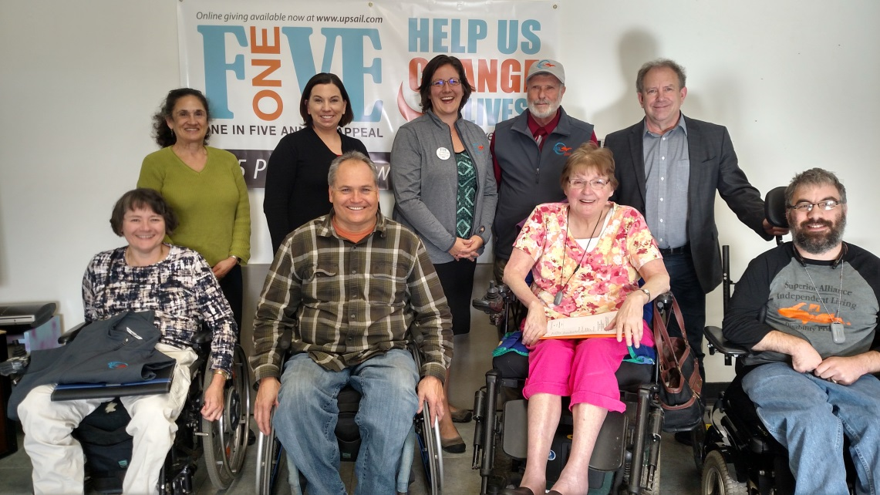
The last 5 years (continued)
New program is implemented called Mission: Healthy U.P. Vets
$30,000 is secured for Sled Hockey program
One in Five Annual Appeal is developed and launched, raising $26,000
Board engagement is enhanced to support and help stabilize a thriving and growing organization by reviewing all policies, revising employee handbook and by-laws, formulating and executing strategic plan and cultivating more board members

Slide 10
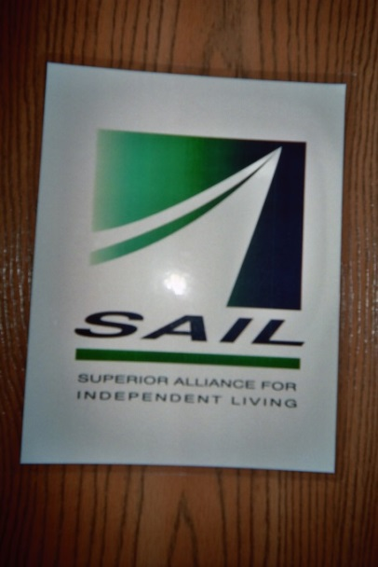



The evolution of the SAIL logo

Slide 11

Community events

Slide 12
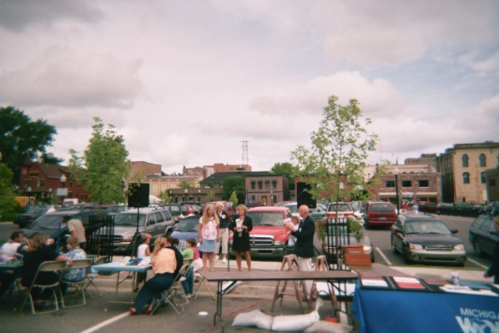
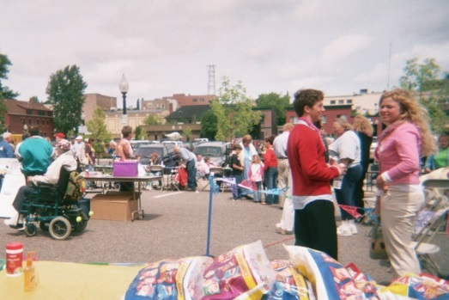
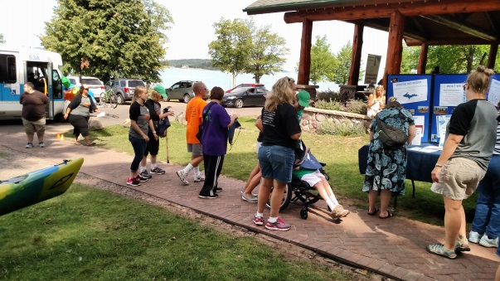
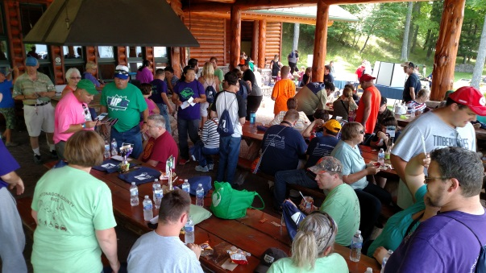
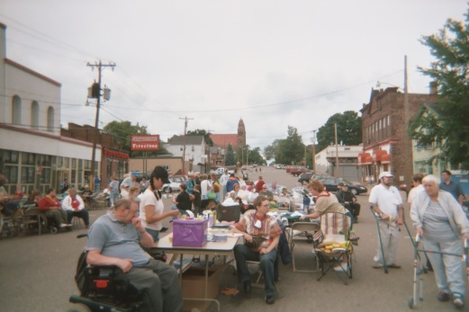
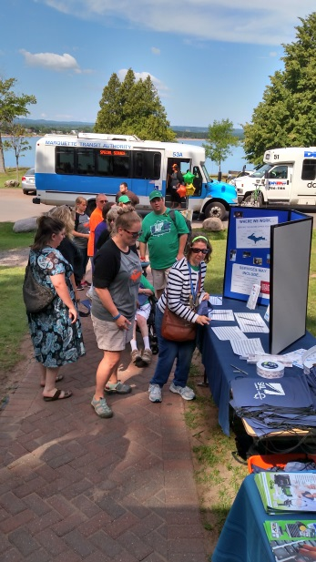
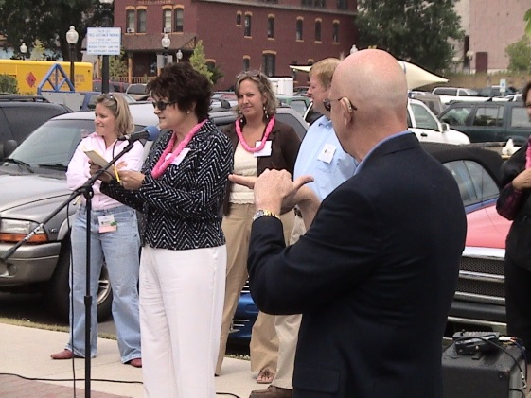
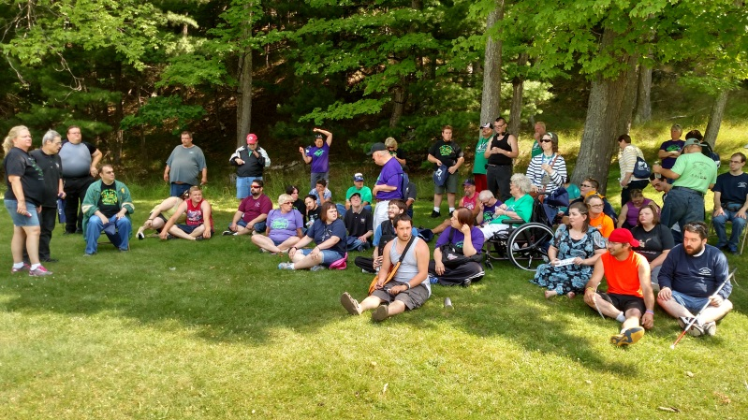
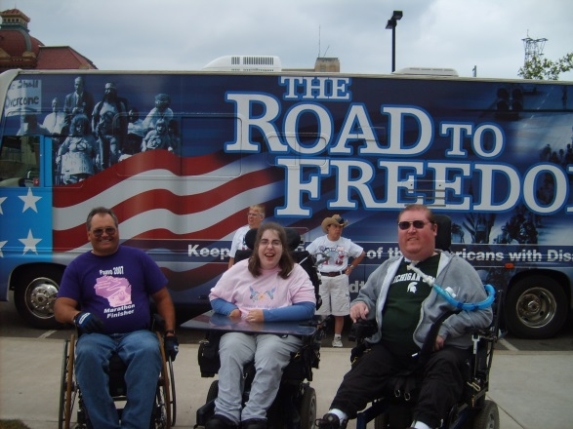
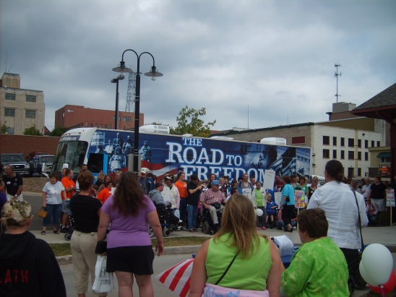
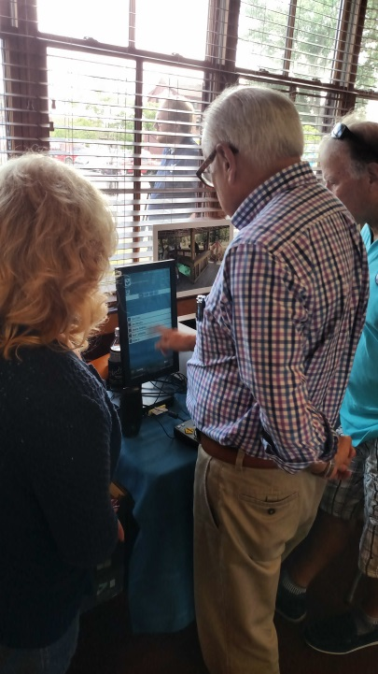
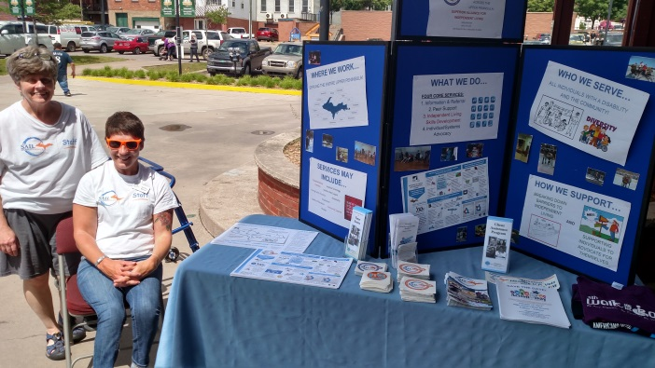
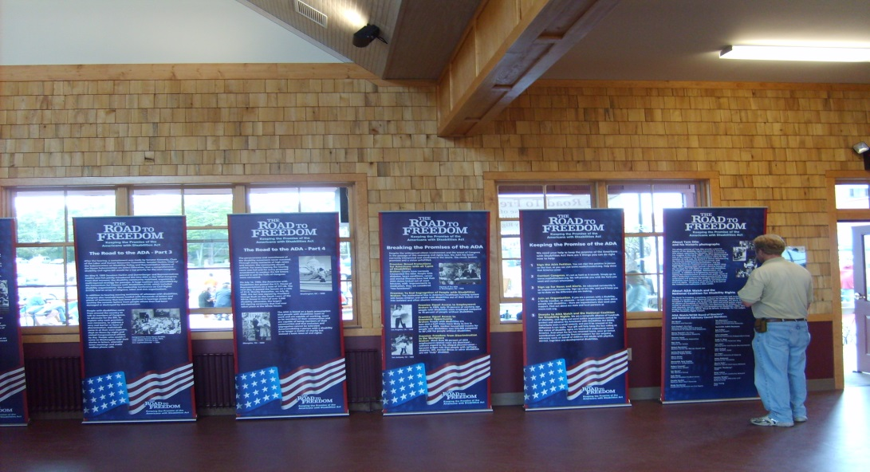
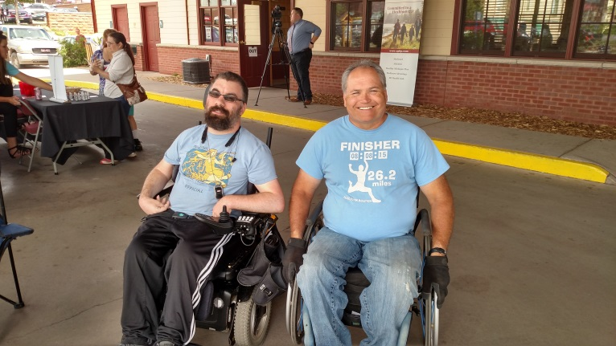
celebrating the ada
ADA Block Party 2005
Disability Awareness and Celebration Picnic 2016
ADA Road to Freedom 2007
Access for All event 2017

Slide 13

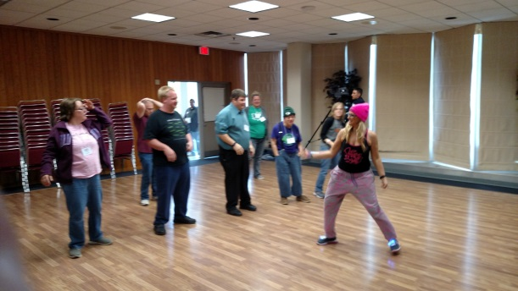
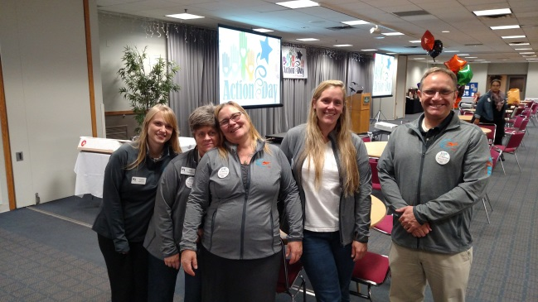


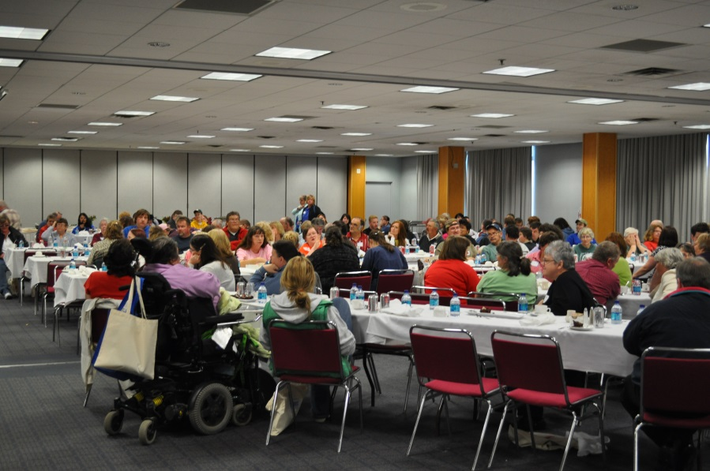
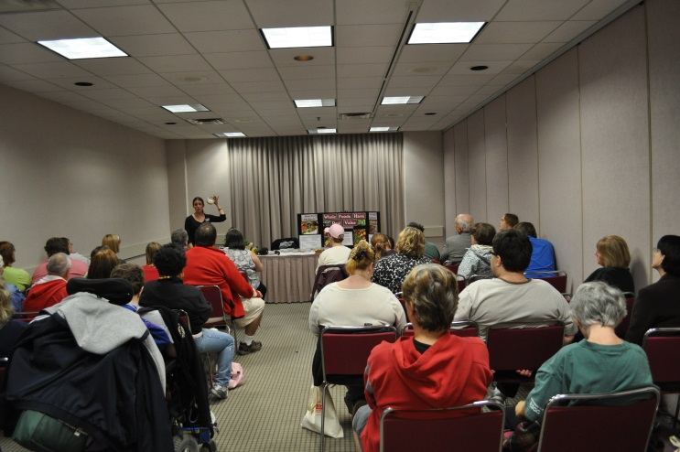
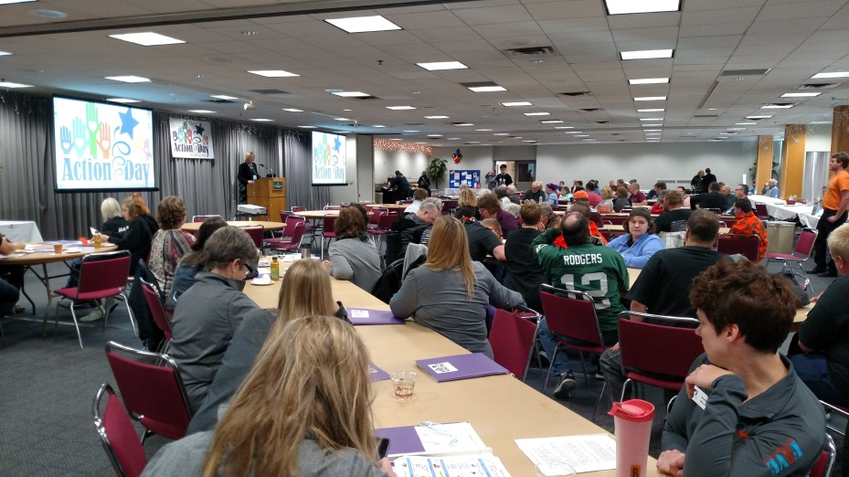
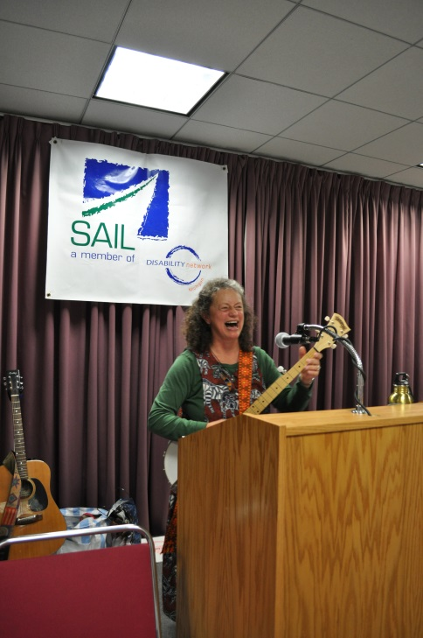
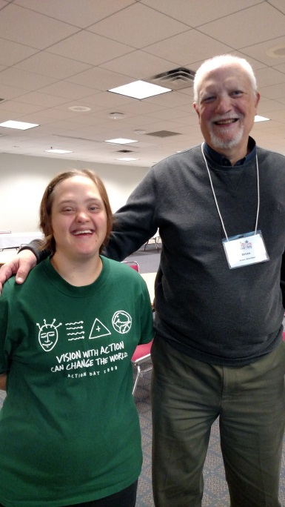
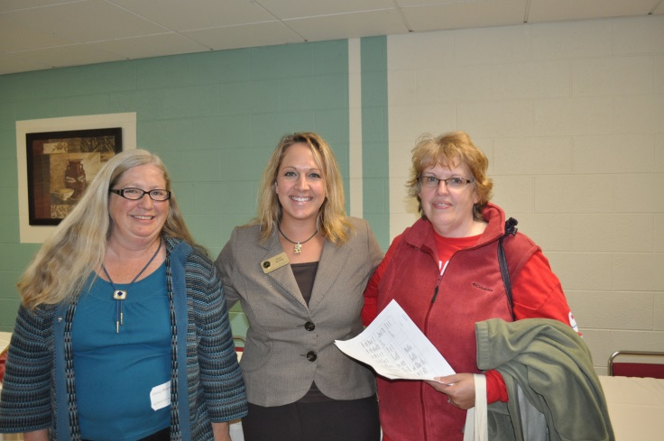
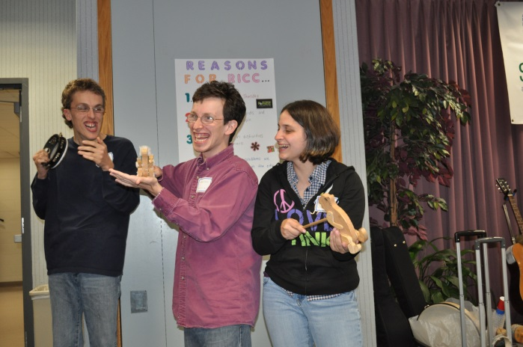
Action DAY conference

Slide 14
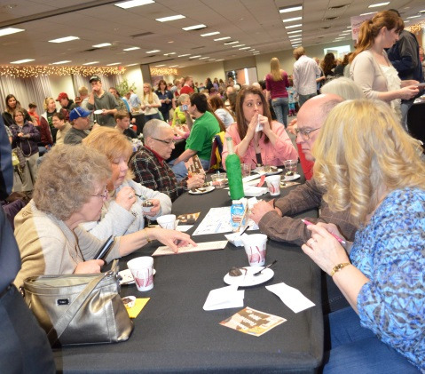
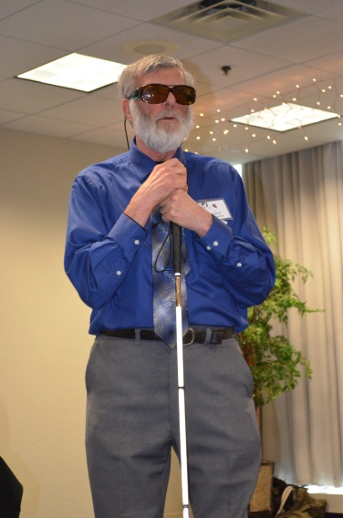
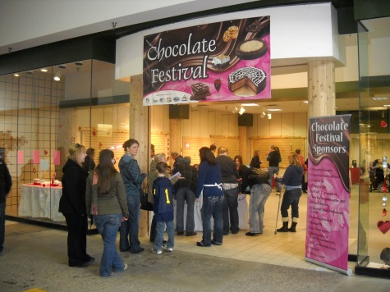
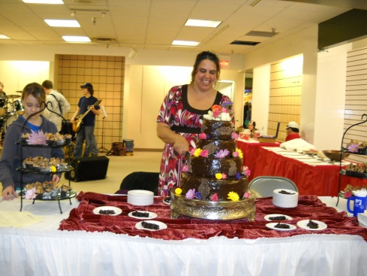

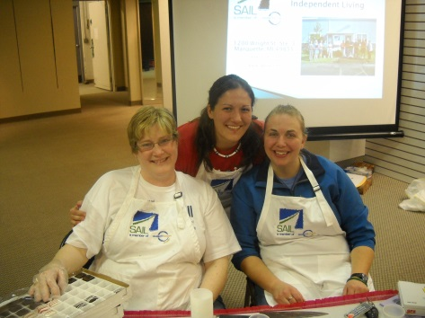
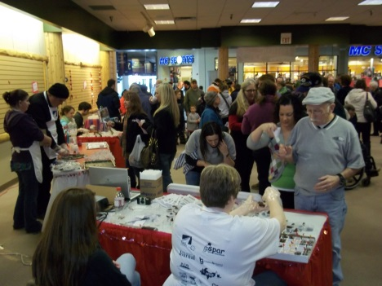
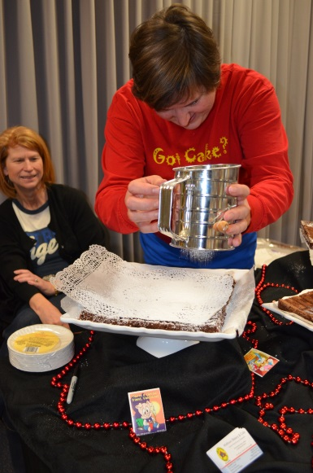
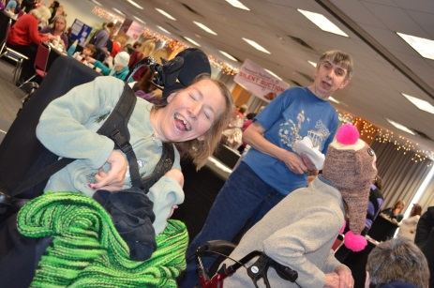
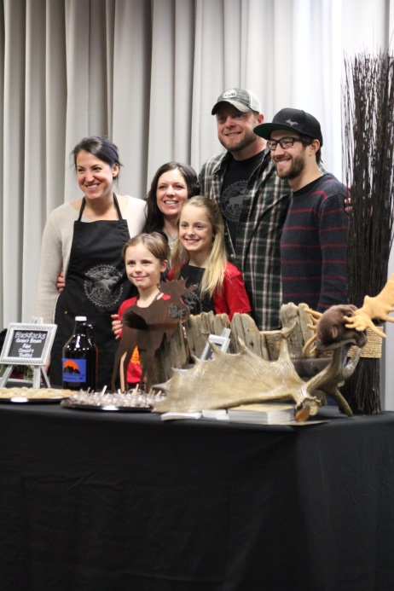
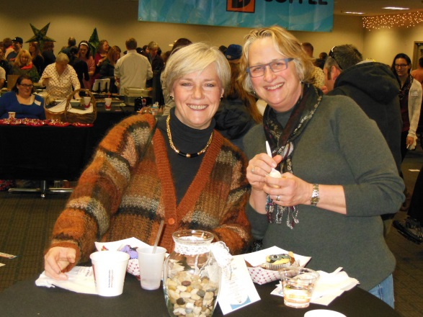
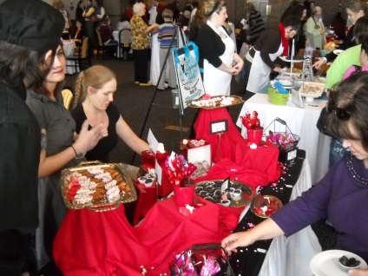
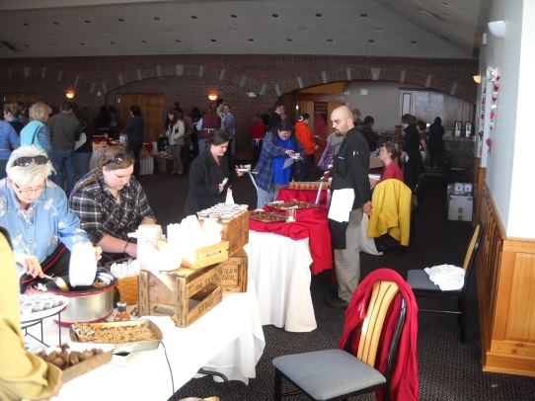
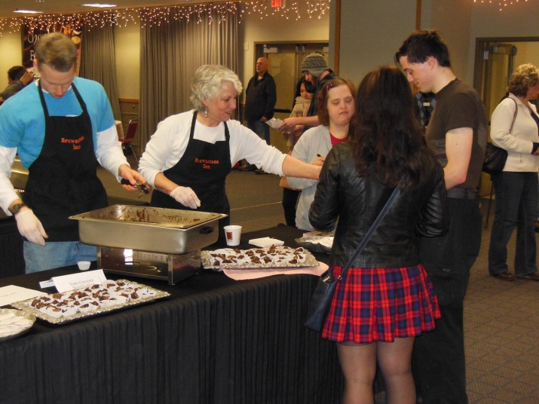

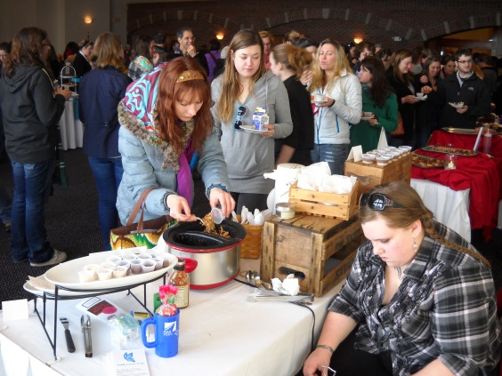

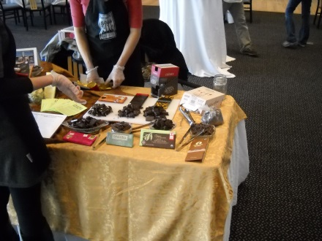
Chocolate festival
Westwood Mall – 2010 -2011
NMU Great Lakes Rooms
2013 - 2017
Up Front & Company – 2012

Slide 15
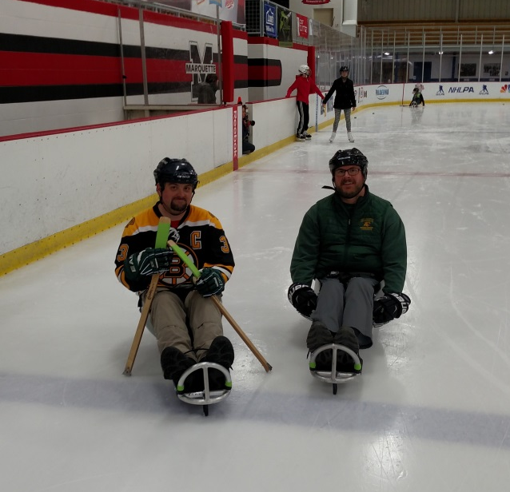
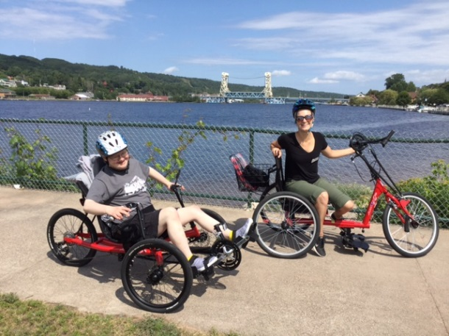
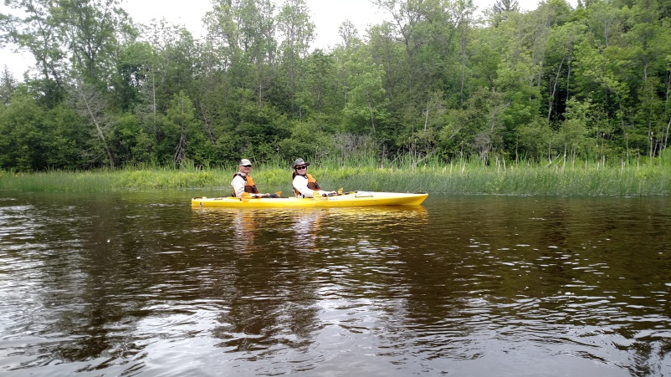
SAIL Commercial released
February 2018

Slide 16
What does the future hold?
SAIL is well positioned to take on additional programs and services that focus on supporting our neighbors in the U.P. that live with a disability.
New strategic plan development is scheduled for Summer 2019!
Key areas identified for growth may include:
        Accessibility programming
        Advocacy for individual and systems change
        Continued outreach to all fifteen counties of the U.P.
        Continued growth in services to assist individuals to attain and retain employment
        Continued growth in independent living services and skills development

